Slide 1
Monthly update
10 20 2023
Ty Bottorff

Slide 2
Outline
Summary of our hypothesis
Progress in mining data from T cell characteristics associated with toxicity to immune checkpoint blockade in patients with melanoma (Newman lab)
Next steps & potential side project idea

Slide 3
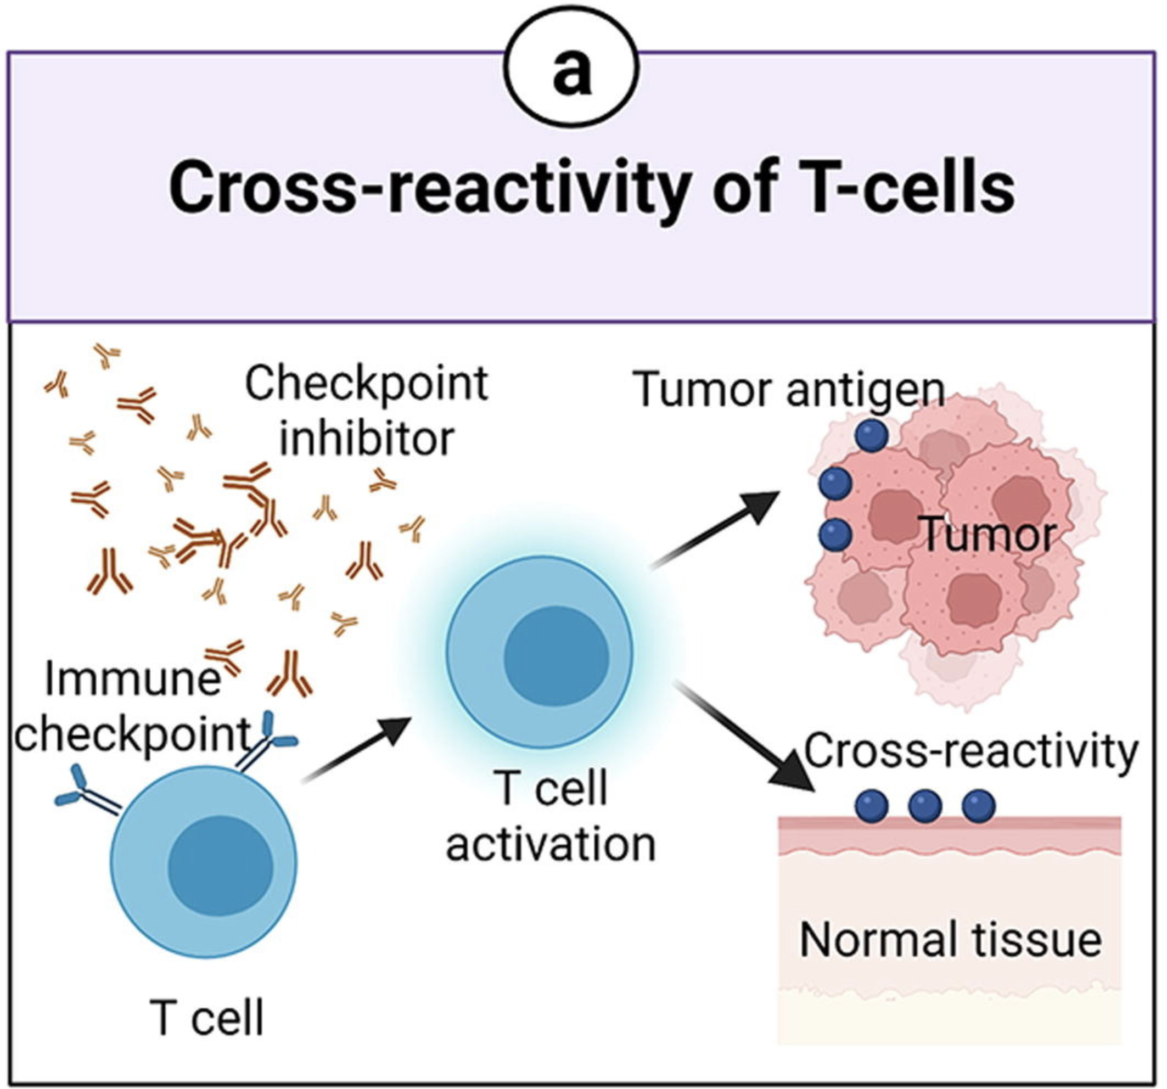
Hypothesis: irAEs might arise due to expansion of cross-reactive T cells reacting to both tumor and self
Rationale
There has been evidence for ICIs inducing expansion of T cells
There has been evidence for irAE development being associated with expansion of T cells
Use TCR features as a proxy for cross-reactivity, study how TCR repertoire features change during ICB
Hydrophobicity: more hydrophobic TCRs might be more cross-reactive
Germline-ness: more germline-like TCRs might be more cross-reactive as they have lower sequence complexity
Length
Notes:
Picture from Advanced materials for management of immune-related adverse events induced by immune checkpoint inhibitors
We want to confirm that TCR expansion is directly related to irAE development

Slide 4
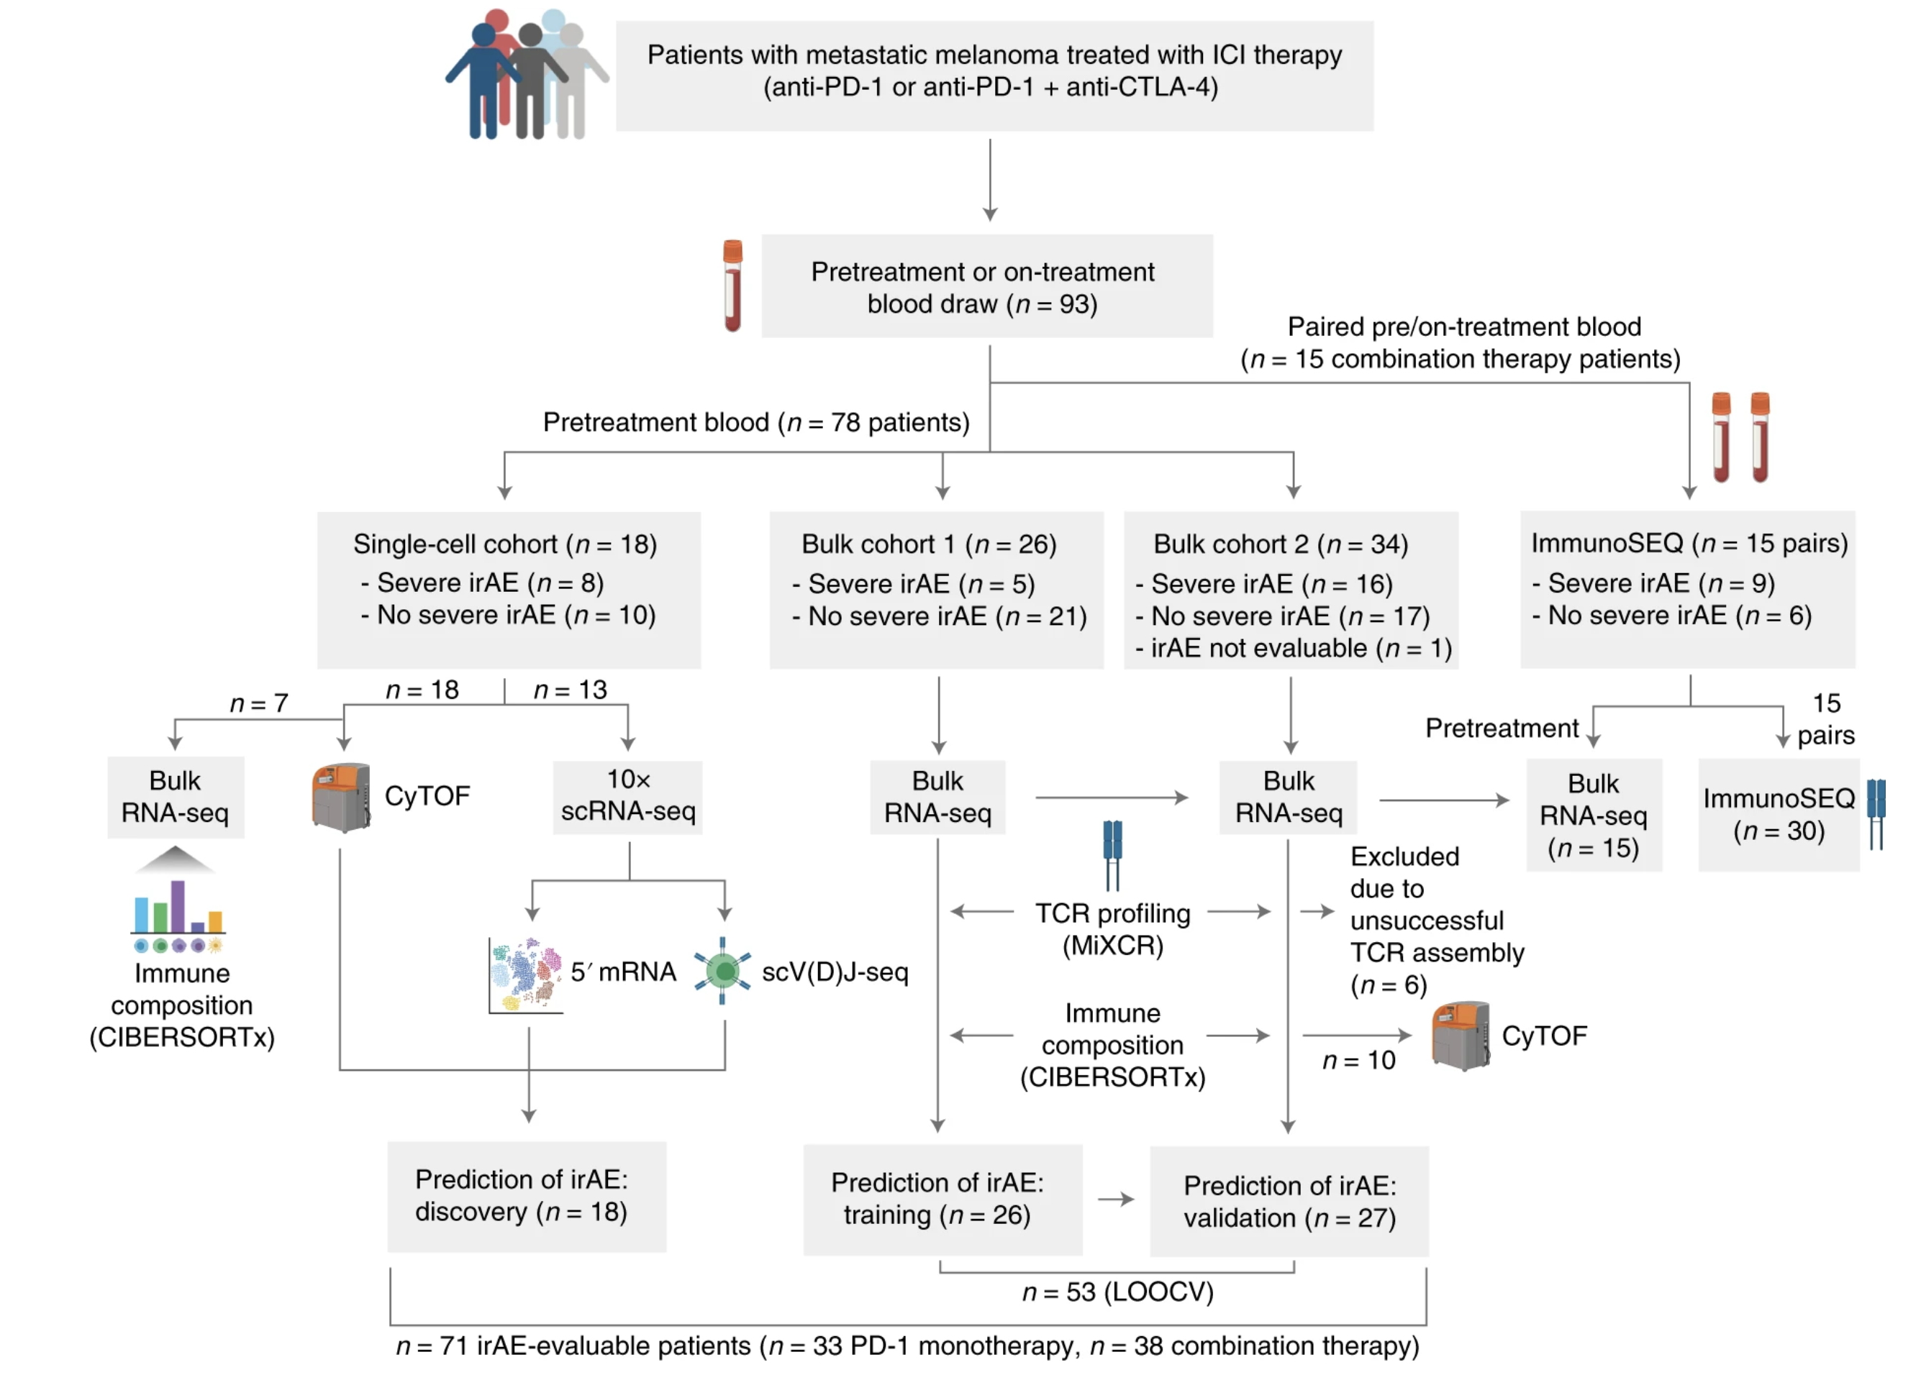
Newman lab paper patient cohorts

Slide 5
Ty’s Methods
Quality control
Integrate across samples
Dimensional reduction
Find clusters, biomarkers
Assign cell types, filter out certain cell types
Repeat 3-5 until done filtering out cell types
Analyze TCR/BCR features by…
cell type
severe irAE development

Slide 6
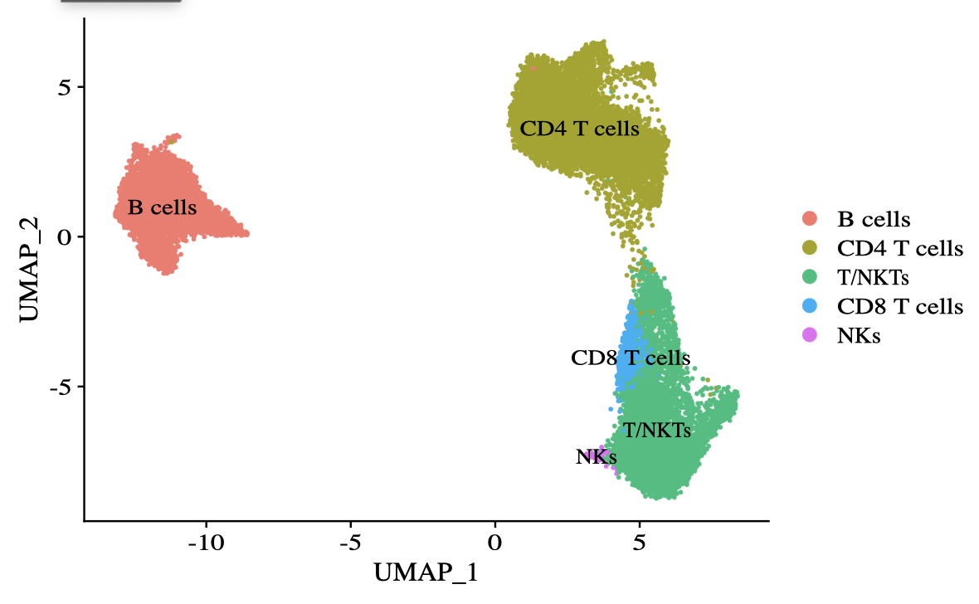
Dimensional reduction, clustering after removing monocytes, DCs (and RBCs, platelets)

Slide 7
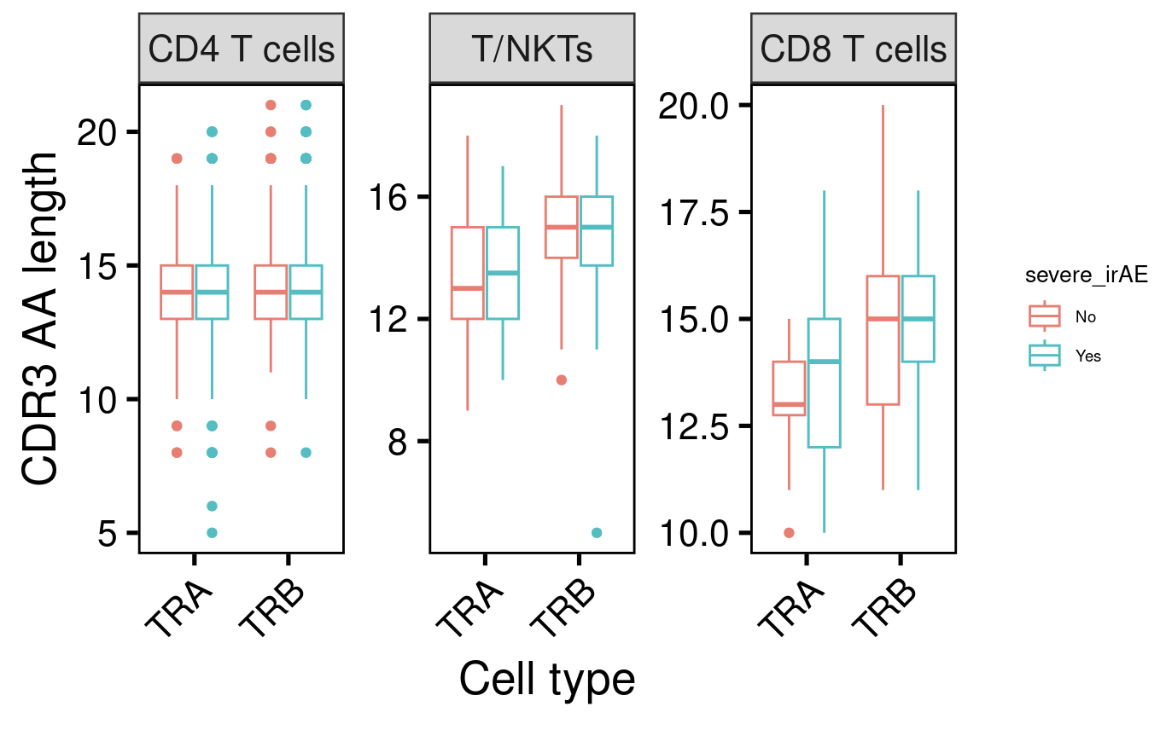
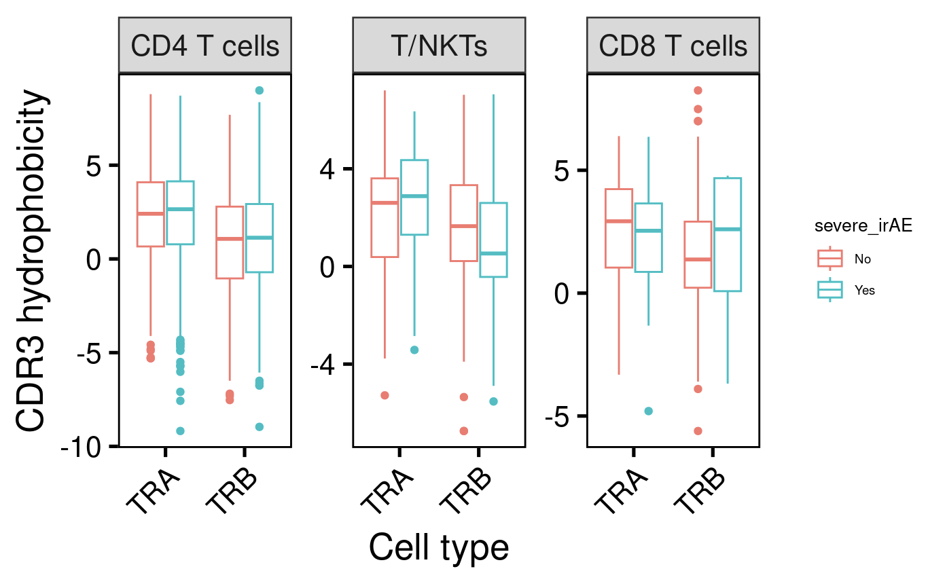
No differences in CDR3 AA length or hydrophobicity among cell types/chains by severe irAE development in bulk analysis

Slide 8
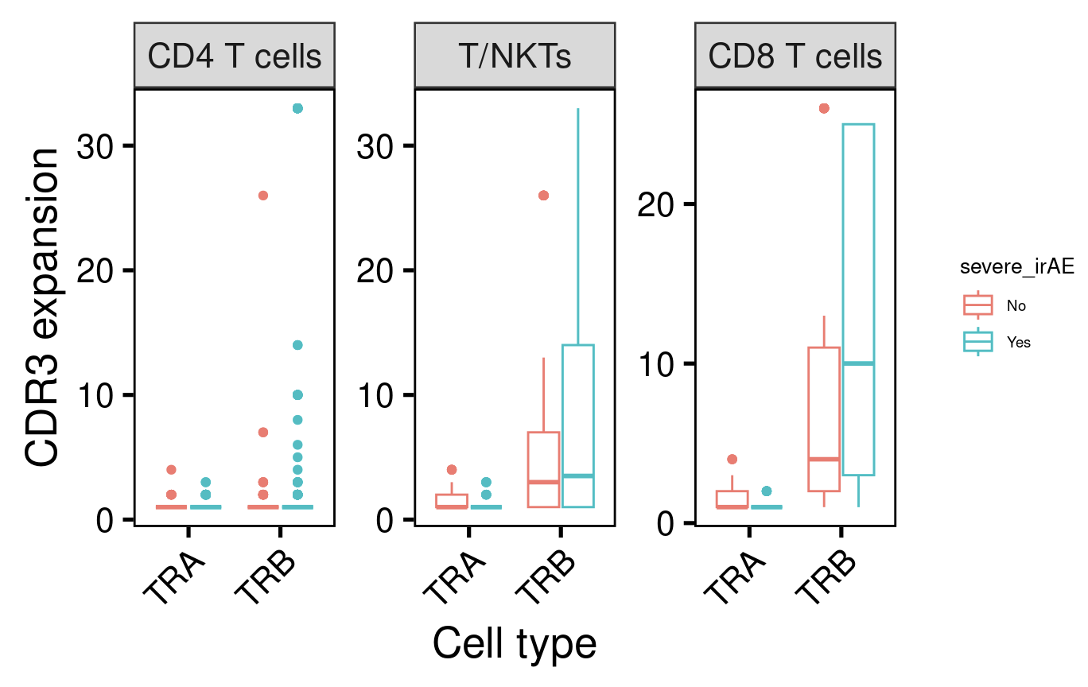
CD8 T cell TRB CDR3 (pre-treatment) expansion may predict severe irAE development in bulk analysis
*
P = 0.02
(Wilcoxon rank sum test)

Slide 9
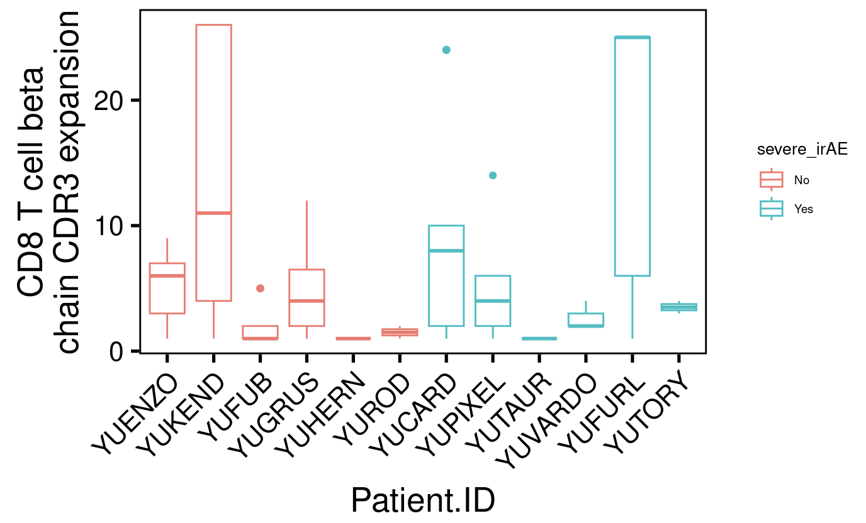
Patient level analysis of CD8 T cell beta chain CDR3 (pre-treatment) expansion in bulk analysis

Slide 10
Stitchr and IGoR & IMGT/HIGHV-QUEST methods
Stitchr
Read in scV(D)Jseq data
Filtered for barcodes with exactly 1 alpha and 1 beta chain
Run Stitchr to get full TCR alpha and beta chain sequences
IGoR & IMGT/HIGHV-QUEST
Run separately for alpha and beta chains

Slide 11
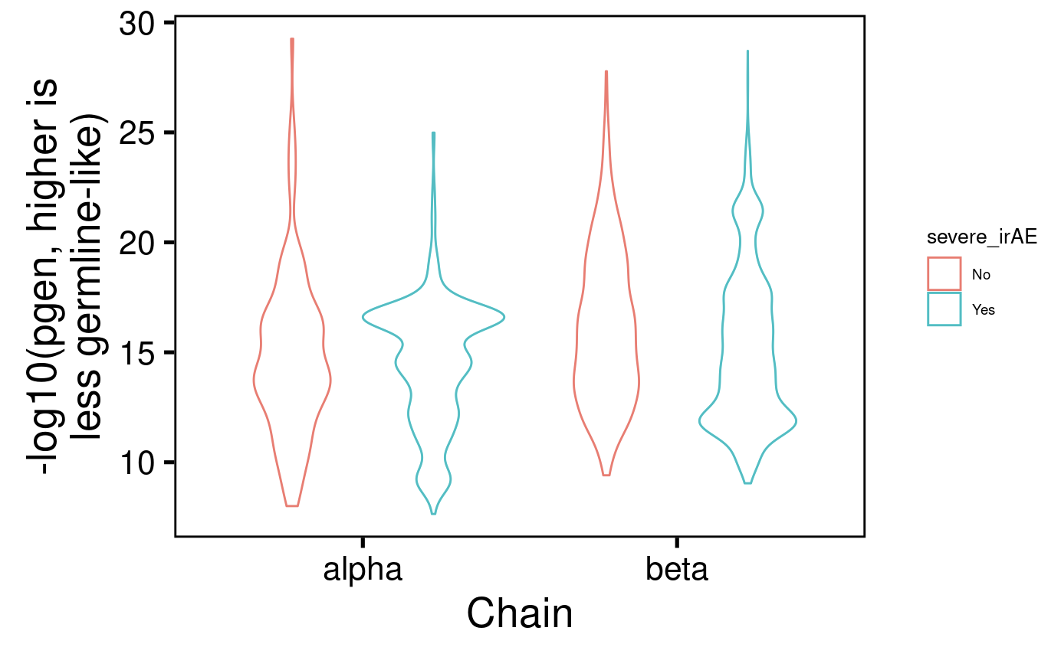
Probability of generation (pgen) scores similar between TCR chains by severe irAE development

Slide 12
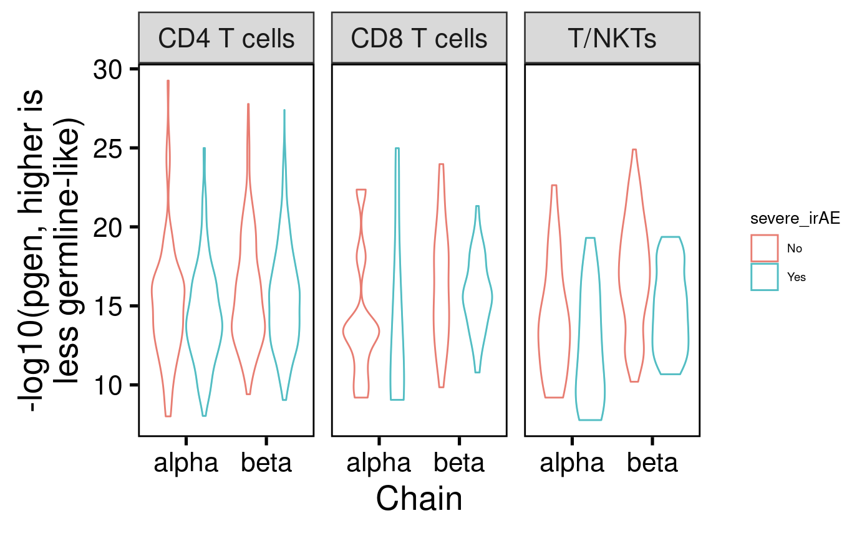
pgen scores similar between TCR chains/cell type by severe irAE development

Slide 13
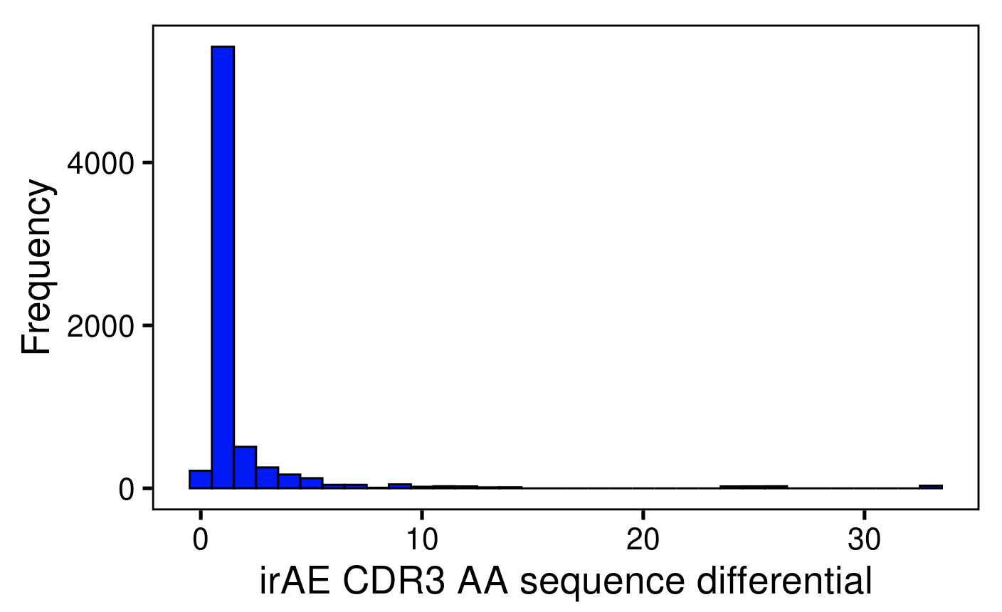
Preliminary analysis of a more pinpointed feature comparison: look at CDR3 sequences differentially encountered in Yes vs. No severe irAE development
All highest are from TRB
CASSQDGYGGADEQYF
CASSLKGGGTGELFF
CASSYEGSYEQYF
CSARGGDGGDTEAFF

Slide 14
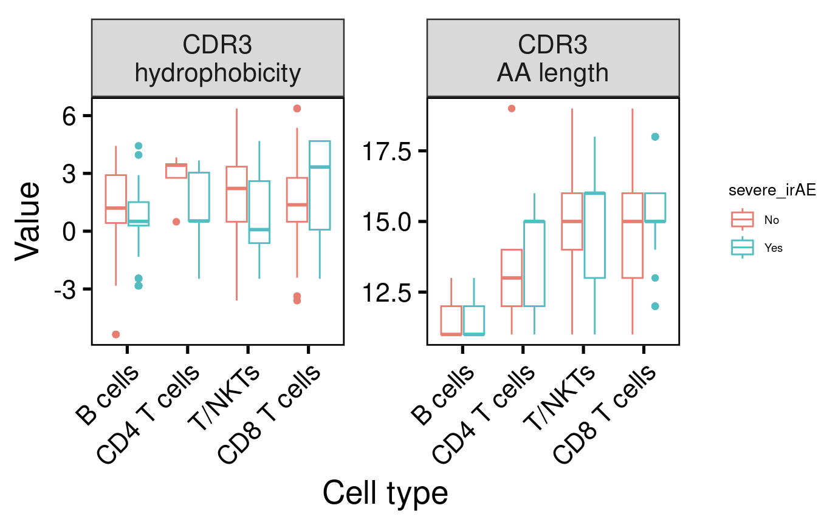
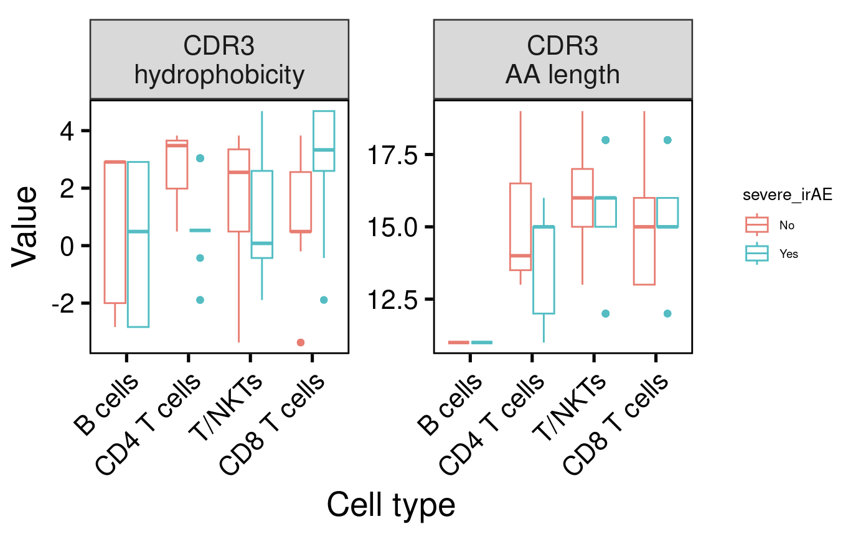
With most differentials being very small, there’s a trade off between higher differential and number of sequences left to analyze
Differential > 3
Differential > 6
Notes:
filter(irae_seq_differential > 10)

Slide 15
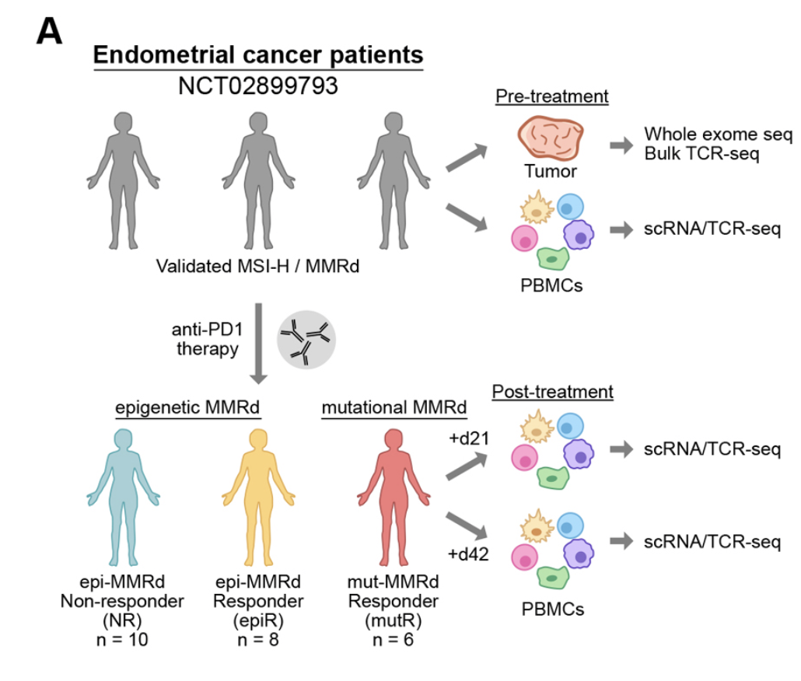
Next steps
Moving onto a new dataset with single cell analyses before AND after ICB → investigate changes in TCR features with ICB: Distinct mechanisms of mismatch repair deficiency delineate two modes of response to PD-1 immunotherapy in endometrial carcinoma
Notes:
scRNA-seq and matched scTCR-seq of PBMCs from 24 patients before and after treatment

Slide 16
Potential side project
Working on Newman lab dataset Ty shared investigation on here
Plan
Look at bulk RNA sequencing data
Find differentially expressed genes between +/- ICB treatment, overlay onto UMAP
Find differentially expressed genes between +/- severe irAE development, overlay onto UMAP

Slide 18
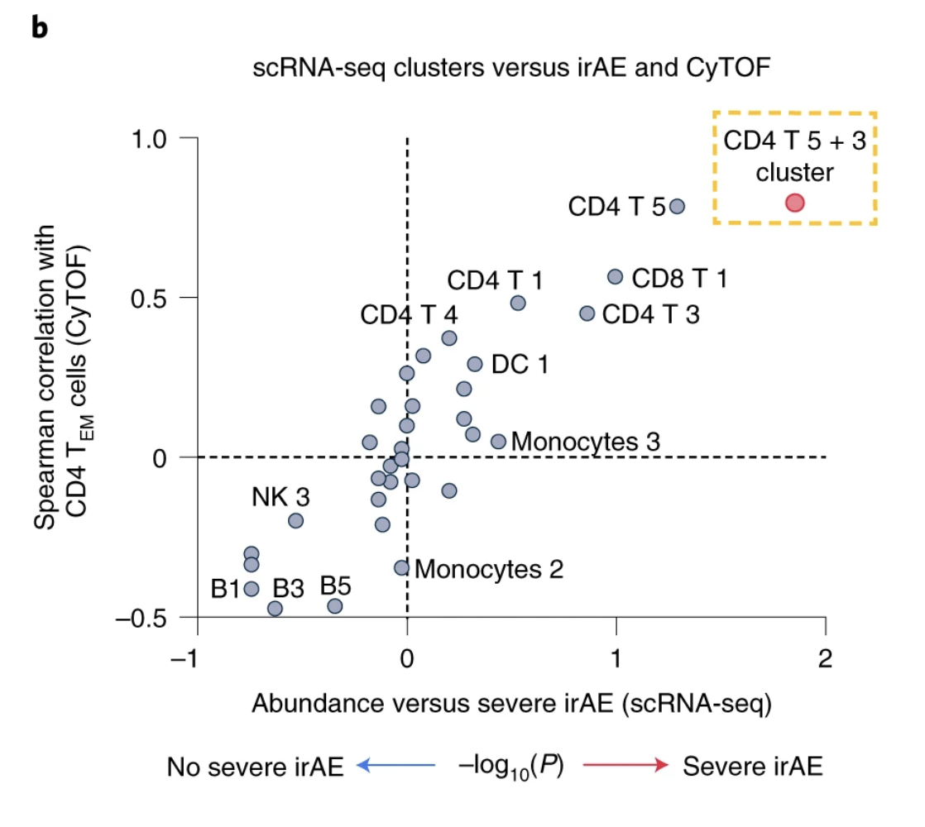
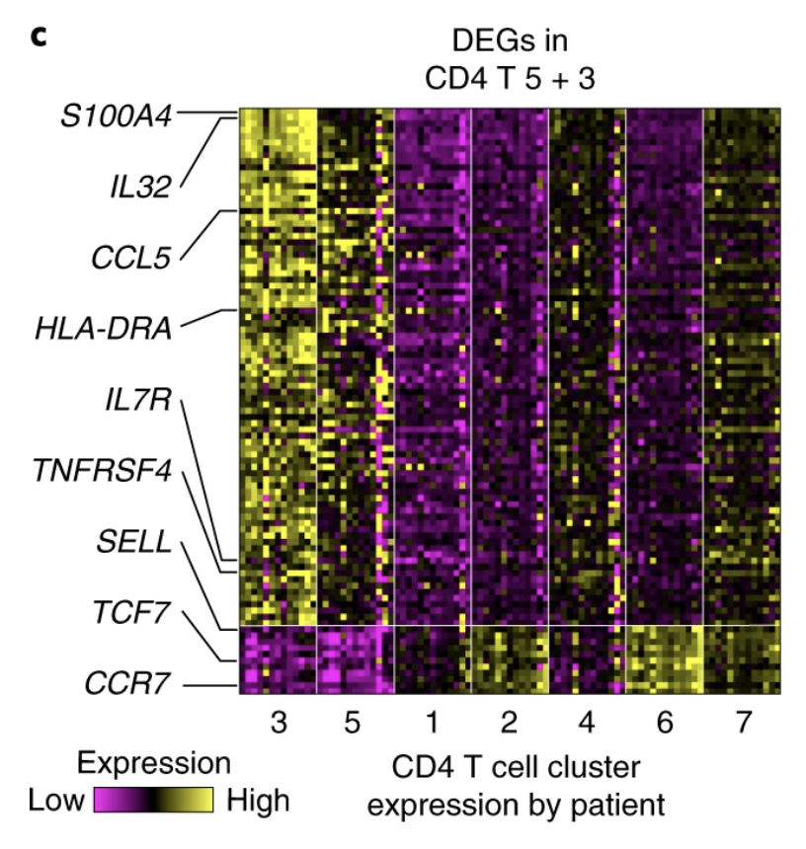
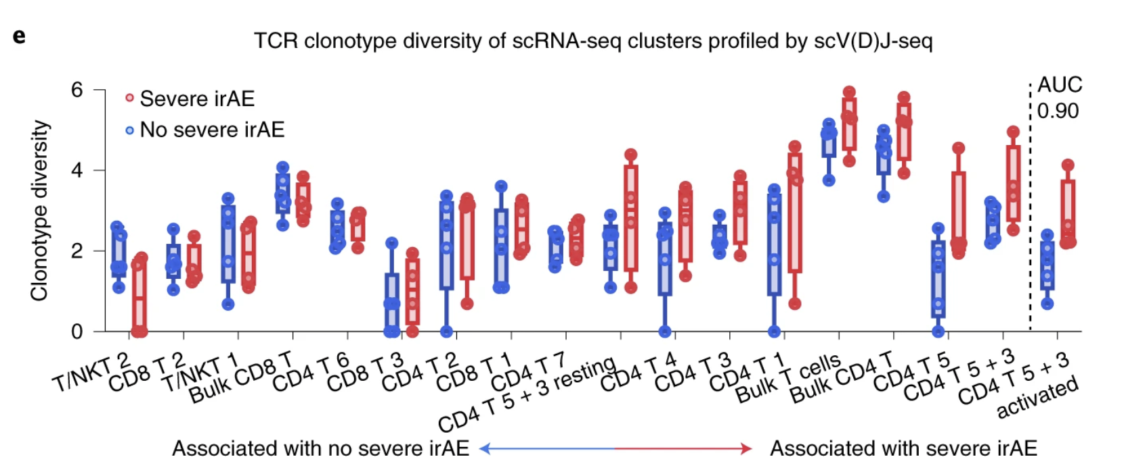
Main findings from Newman lab paper
Activated CD4 effector memory T cell abundance and TCR diversity associated with irAEs in melanoma patients
Notes:
- CD4 effector memory T cells at higher levels in pretreatment blood associated with severe irAE
- also find elevated activated CD4 TM cells in autoimmune disease patients, perhaps a common immunological mechanism between irAEs and autoimmunity
Pretreatment TCR clonotype diversity within each T cell state, total T cells, CD8 T cells, CD4 T cells and activated versus resting CD4 T 5 + 3 cells (defined as in d), grouped by future irAE status. TCR diversity was calculated for all patients with at least 100 TCR clones (n = 9; Methods). States are ordered by the AUC between TCR diversity and severe irAE status. Activation refers to CPM > 0 of HLA-DX and MKI67

Slide 19
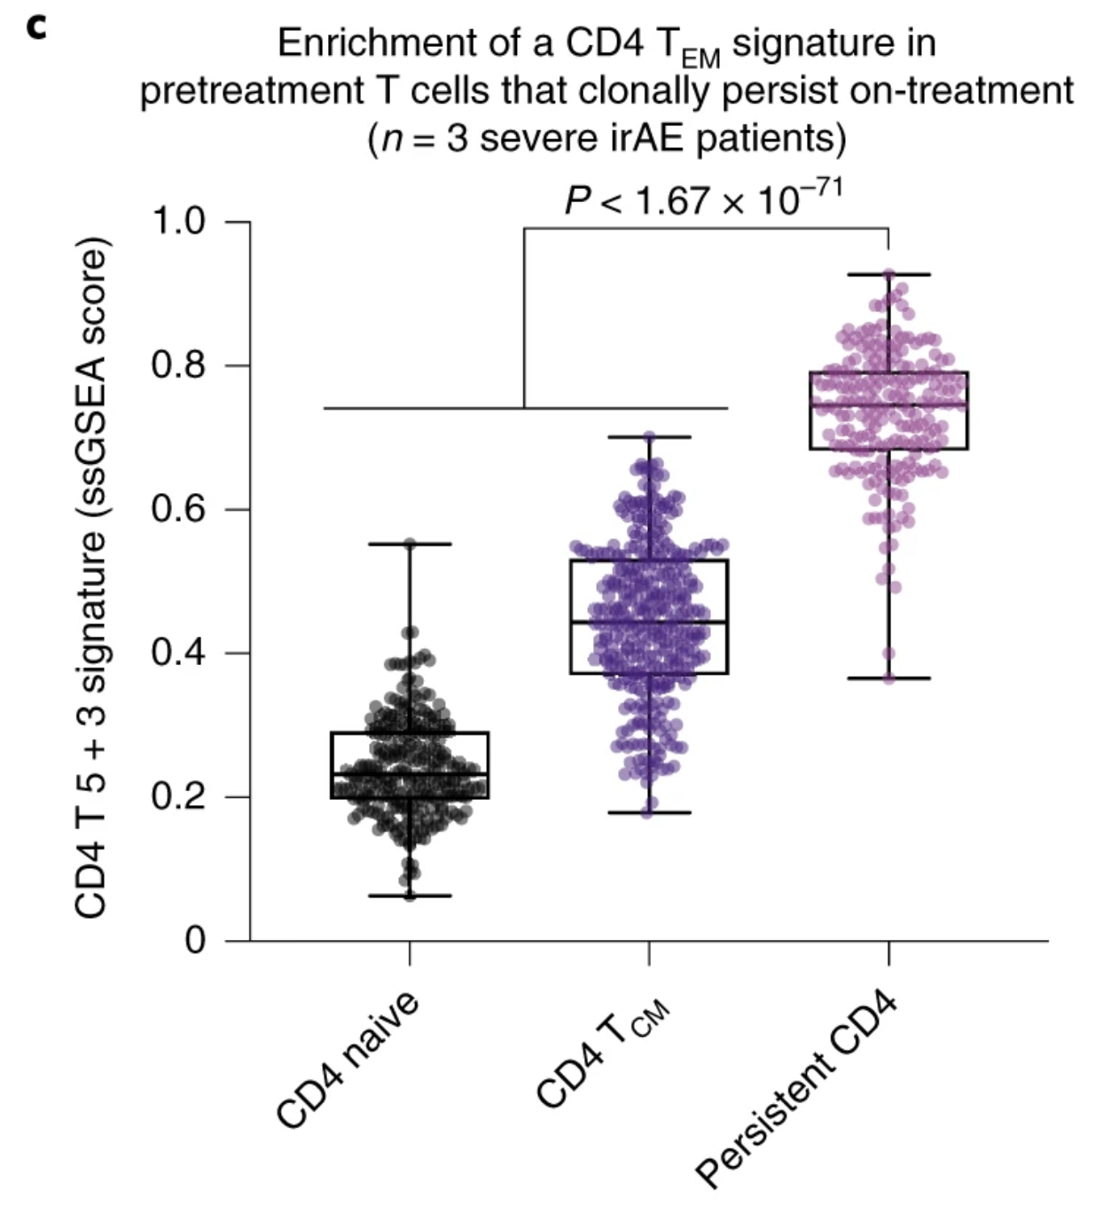
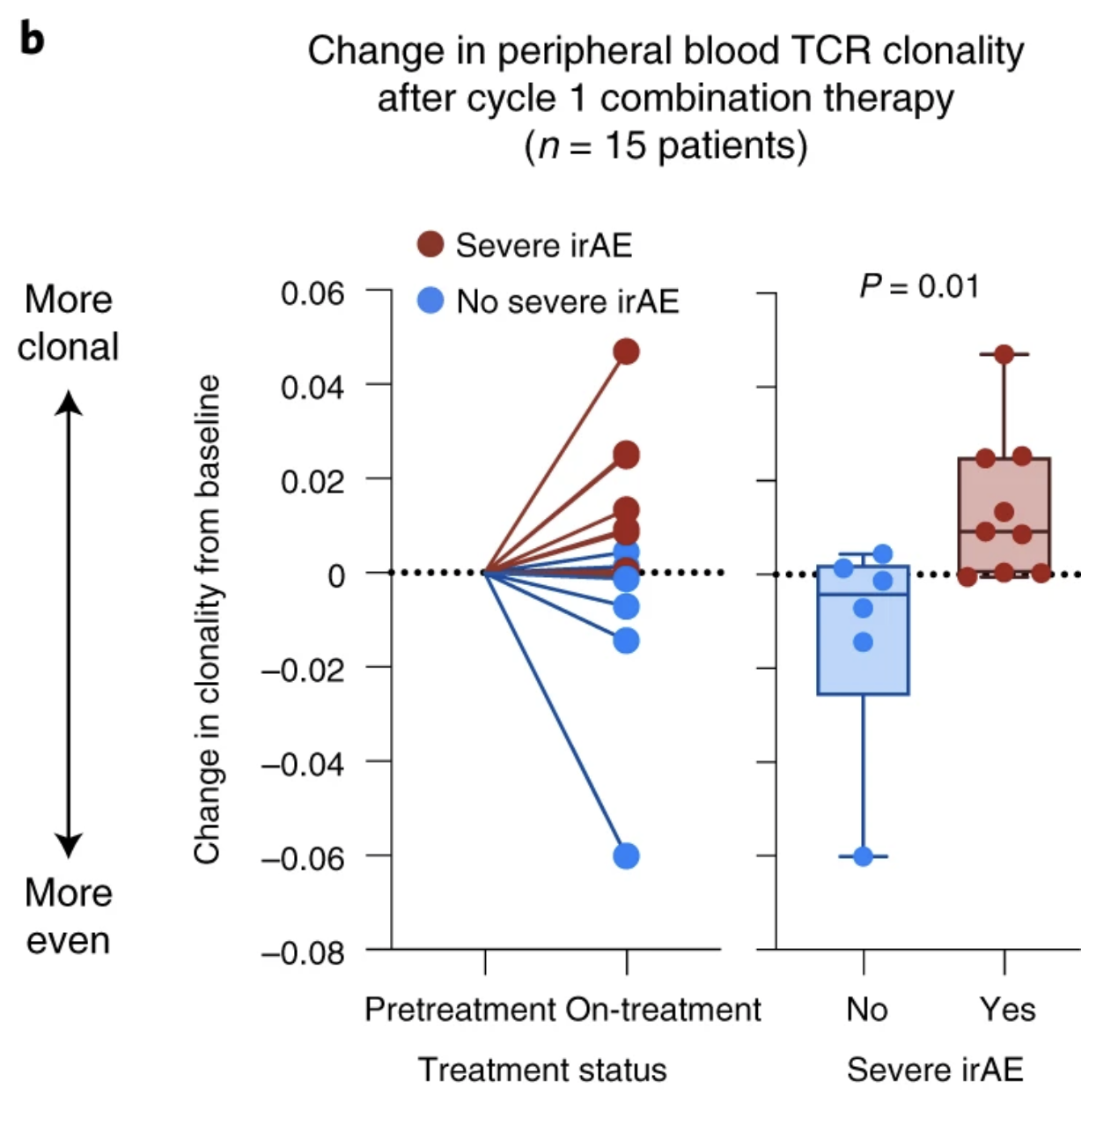
Main findings related to T cell clonal expansion
increased TCR clonal expansion and persistence of baseline clones in patients developing severe irAEs (preferential expansion of activated CD4 T_{EM})
Notes:
- prior evidence of clonally expanded self/virus-reactive T cells in affected tissue linking self/pathogen-recognizing T cell clones to irAEs (**I wonder why viral antigen recognition would lead to irAEs, good for the viral-infected cells to be attacked, right? but perhaps its an inappropriately strong immune response**)
c, Enrichment of a CD4 T 5 + 3 gene signature in CD4 T cells from pretreatment PBMC samples obtained from 3 patients analyzed in b, all of whom developed severe irAEs and showed TCR clonal expansion after ICI initiation (Extended Data Fig. 9d). The box center lines, box bounds and whiskers indicate the medians, first and third quartiles and minimum and maximum values, respectively. The points denote cells profiled by scRNA-seq and annotated either by Azimuth (CD4 naive, n = 245 cells; CD4 T_{CM}, n = 320 cells) or by their clonal persistence from baseline to early on-treatment time points (persistent CD4, n = 190 cells). The most persistent CD4 clonotypes in this analysis showed evidence of clonal expansion (Extended Data Fig. 9f,g). Significance was determined relative to persistent cells by a two-sided, unpaired Wilcoxon rank-sum test. ssGSEA, single-sample GSEA.

